Slide 1





FALL DETECTION
USING COMPUTER VISION
BY: BE RIDING FOR A FALL
UNDER SUPERVISION OF:
ACICT
ENG. ESLAM ELREEDY

Slide 2


CONTENT
01
TEAM MEMBERS
02
PROJECT IDEA
03
PROJECT STEPS
04
PROJECT DEMO
05
NEXT STEPS
06
CONCLUSION
07
END

Slide 3

TEAM MEMBERS
Members
Abdallah Hassan Abdallah
John Lorance William
Mahmoud Ahmed Mohamed
Sameh Ossama Nabil
Ziad Nasser Shaaban

Slide 4

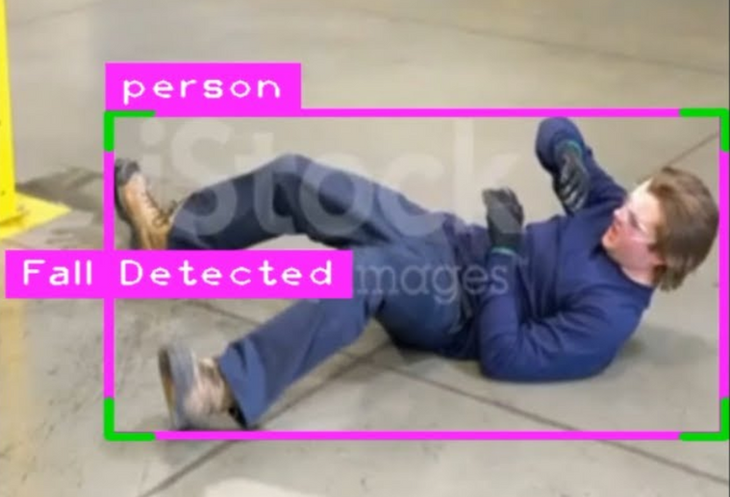
PROJECT IDEA
This project aims to develop an AI system that uses computer vision to detect human falls in real-time and trigger an alarm.
It is designed to monitor patients in hospital rooms or workers in industrial environments, automatically alerting caregivers or emergency personnel when a fall occurs.
The system improves safety by reducing response times and ensuring immediate assistance in high-risk situations.

Slide 5

PROJECT STEPS
Video Input: It uses a camera or a video file to capture real-time footage of the area being monitored.
Object Detection: The program identifies people in the video using a smart model that recognizes shapes and movements using PyTorch (torch) with YOLOv5 model.
Pose Analysis: It examines the body position of detected individuals to determine if they are standing or have fallen using Mediapipe.
Alert System: If a fall is detected, the program plays an alert sound to notify caregivers or emergency personnel using Winsound.
User Interface: The video feed with detection information is displayed on the screen, allowing users to see what the system is monitoring by using OpenCV (cv2) and CVZone.
Real-time Monitoring: The program continuously checks the video frames, ensuring prompt detection and response to any falls using OpenCV (cv2) and Threading (threading).

Slide 6

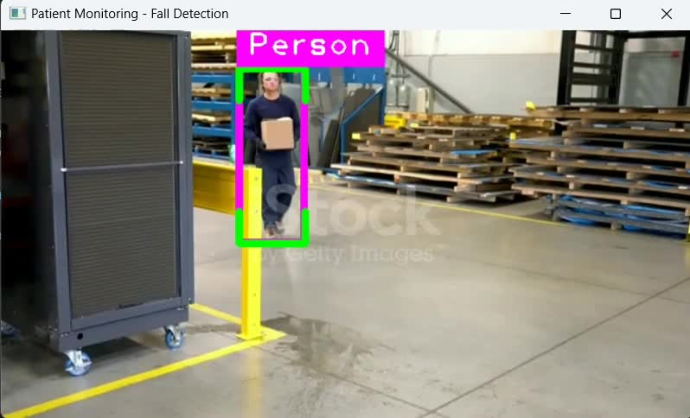
PROJECT DEMO 1

Slide 7
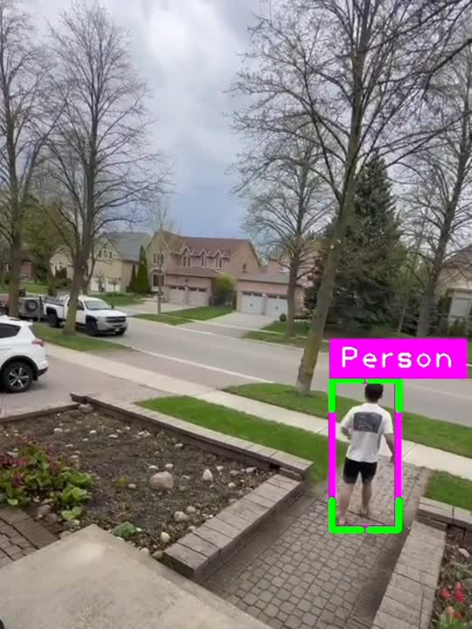
PROJECT DEMO 2

Slide 8


NEXT STEPS
Some ideas on how we can improve the model further in the future.
Implement analytics to monitor patterns of falls over time, which can help in assessing risks and improving safety protocols.
Integrate an emailing or SMS service to send instant notifications to caregivers or family members when a fall is detected.
Refine pose estimation to include more detailed posture analysis, potentially identifying risky behavior before a fall occurs.
REAL-TIME DATA ANALYTICS
ADVANCED ALERT SYSTEM
ENHANCE POSE ANALYSIS

Slide 9
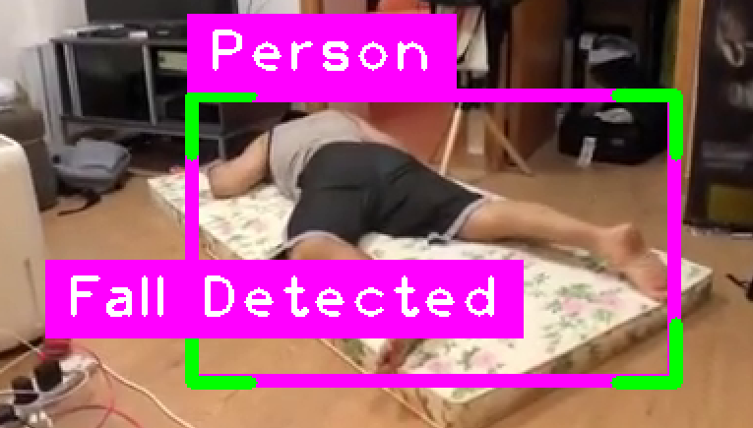




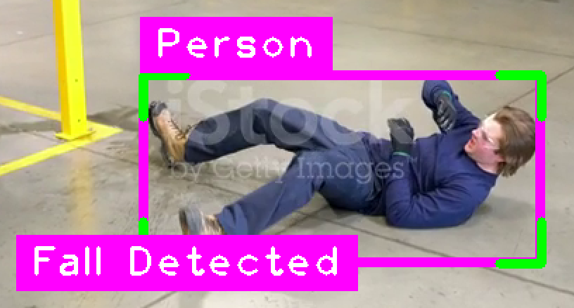

CONCLUSION
As we have seen form the demos:
The system was able to detect that a person was in frame.
It detected that the person fell down.
Emitted and alarm when the person fell down.

Slide 10


THANK YOU

